Slide 1
Understanding the digital ecosystem

Slide 2
CONSUMERS SPEND 12 hours per month WITH DIGITAL video content
Q2 ‘09 to Q2 ’13
% Change
Total Monthly Time Spent (hh:mm)
+7.7%
147:29 | 150:44 | 155:06 | 156:05 | 158:50
+ 77%
+ 103%
Monthly Time Spent per Person (hh:mm)
+ 4%
Source: Nielsen Cross-Platform Report data, *Online streaming data for Q2 2010 –Q4 2010 are smoothed for a consistent trend line as data were not available for this time period. TV and Online based on Persons 2+, Mobile 13+

Slide 3
Digital ratings

Slide 4
ONE AD TO MANY PEOPLE
PC
LAPTOP
AD
AD
DIGITAL PUBLISHER
AD
Measures a representative piece
BROWSER
APP
MANY ADS TO MANY PEOPLE
LINEAR AD MODEL
AD
AD
TV NETWORK
AD
SMARTPHONE
TABLET
Measures every piece
DYNAMIC AD MODEL

Slide 5
Measurement scope
Online Campaign Ratings
ad performance
Digital Program Ratings
Video content performance
Mobile
impressions for Online Campaign Ratings/
Digital Program Ratings
Credit mobile viewing to linear TV ratings
LPM Markets 2014
Linear Ad Load
Dynamic Ad Load
All activated with a single SDK integration

Slide 6
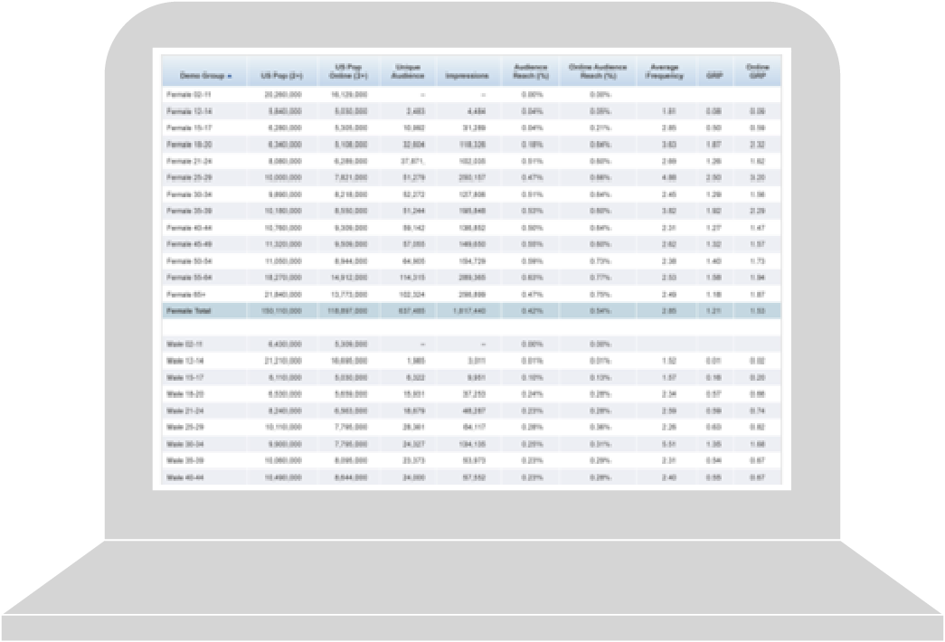
Nielsen online campaign ratings
Accurately identifies the audience via actual registered user demographics from data providers
Evaluates unique reach, frequency, GRPs and viewability across campaigns, and within each publisher daily
50-60%
sample coverage for actual user demographics
Gross Rating Points (GRPs) outputs for ad campaigns are comparable to Nielsen TV Ratings
Nielsen Online Campaign Ratings User Interface
Non-panel based approach allows for measurement of small campaigns and accredited by the MRC*
*Nielsen Online Campaign Ratings is accredited by the Media Rating Council (MRC). Featured elements including DMA, viewability is not currently accredited, but are undergoing review by MRC.

Slide 7

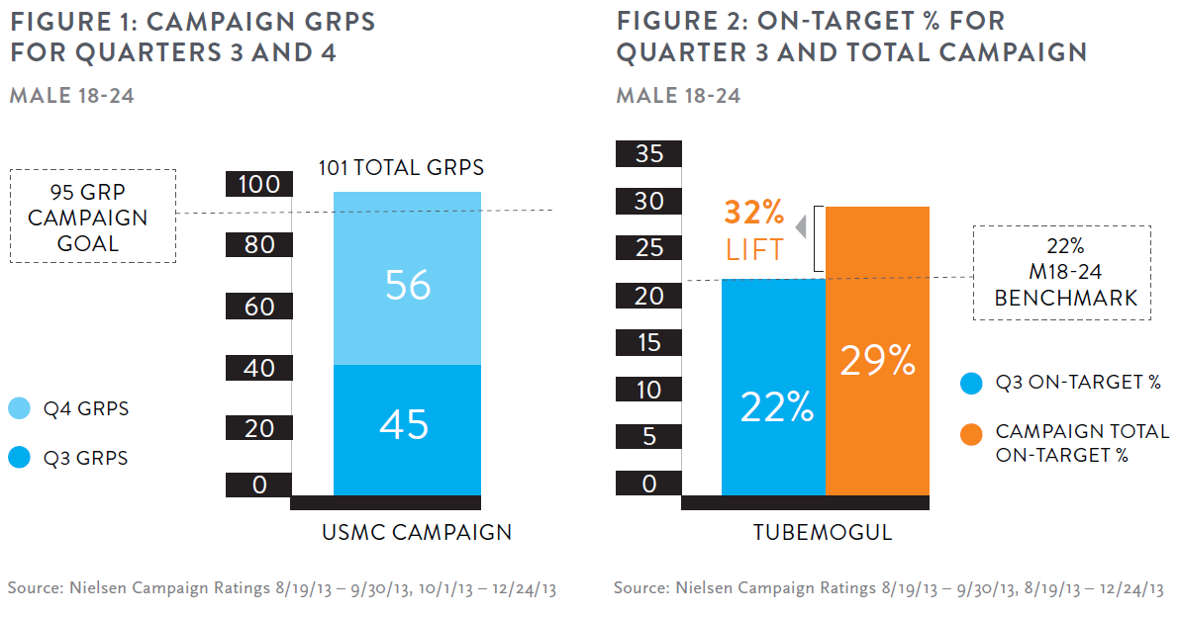
US Marine Corps optimize results

Slide 8
XCR Example: Beverage company quantified unduplicated and incremental reach for campaign
Target: Persons 2+
50.7% Unduplicated Reach*
(224 GRPs)
Key Findings
Television commercials were aired on major broadcast networks and online buy included a wide range of general interest sites
The digital ad buy delivered substantial incremental reach of 8.4% of the US pop
Over 60% of the people exposed to the digital campaign only viewed it online
36.9%
TV-
only
reach
5.4%
Cross-
Platform
reach
8.4%
Digital-
only
reach
42.3%
TV reach
(147 GRPs)
13.8%
Digital reach
(77 GRPs)
* Reach numbers based on common total US population universe of 296,810,000 persons

Slide 9
mobile ratings IN XCR
Mobile Update
Mobile OCR Release 1 (Q2 2014)
Duplication between TV+OL and OL+mobile (as in OCR)
Future Mobile OCR Release
Fully unduplicated reach measurement
TV
TV
Online
Online
Mobile
Mobile

Slide 10
Quantify your audiences: TV and digital
Dynamic
Digital Program Ratings
Share stats like:
12 million
Watched on TV and
3 million
Watched on digital devices
How does your digital audience differ from TV?
Are your digital audiences younger? Are they the same?
Digital devices include online, mobile, and tablet
Illustrative

Slide 11
Digital program ratings Overview
Dynamic
MEASURES AUDIENCES WATCHING YOUR VIDEO CONTENT ON DIGITAL DEVICES
COVERAGE
Age/Gender audience of TV video
content online
DATA
Consistent data & reporting – R/F/GRPs, overnights at episode granularity
COMPARABILITY
Highly accurate, overnight audience comps for TV content
METHODOLOGY
Built on Campaign Ratings platform and methodology
Available for online and mobile/tablet devices
Notes:
ONLY AVAILABLE FOR CONTENT OWNERS
Now we are looking to complete the picture by applying this methodology to measure programs. In 2013 we will launch Online Program Ratings, which will apply the same measurement methodology used in OCR to online television content. For the first time, publishers will have highly-accurate overnight data describing their audiences based on age/gender and delivered as a GRP. With this data, publishers should have confidence selling their inventory based on an OCR guarantee. While the initial focus will be measurement of online TV, we are working on including measurement of non-video and non-TV content as well.
We are also working to integrate these metrics into the systems used by publishers and agencies to plan multi-platform campaigns.

Slide 12
Measurement scope
Online Campaign Ratings
ad performance
Digital Program Ratings
Video content performance
Mobile
impressions for Online Campaign Ratings/
Digital Program Ratings
Credit mobile viewing to linear TV ratings
LPM Markets 2014
Linear Ad Load
Dynamic Ad Load
All activated with a single SDK integration

Slide 13
Precision marketing

Slide 14



Plan and Activate: Reach audiences that matter
Premium Data Sets
Segmentation | CPG/Buyer Behavior |  |  | TV Viewership
Demographics & Lifestage Information | Nielsen Catalina, Nielsen Buyer Insights |  |  | TV Audience
Segmentation | Catalina FSD | Nielsen HomeScan | Nielsen Buyer Insights | TV Panel | Cross Platform Homes Panel
66 PRIZM segments 58 P$YCLE segment (financial habits) 53 ConneXions segments Scarborough Virtually all U.S. households HH, zip, DMA, etc. levels | 60MM+ shopper HH Leading US retailers | 100K HH panelists | 90% of online and offline credit card transactions in the US | 21K HH 50K People 210 DMA’s | ~8500 HH panelists

Slide 15
Programmatic

Slide 16
In the Beginning, there were advertisers and publishers
ADVERTISERS
AGENCIES
AD SERVER
AD SERVER
PUBLISHER
CONSUMER
DIRECT BUY

Slide 17
Ad Networks appeared, to aggregate inventory from multiple publishers
ADVERTISERS
AGENCIES
AD SERVER
AD SERVER
PUBLISHER
CONSUMER
DIRECT BUY
AD NETWORK
Pub
Pub
DIRECT BUY
Pub
Pub
Pub

Slide 18
Demand Side Platforms (DSPs) and Exchanges are aggregating even further
ADVERTISERS
AGENCIES
AD SERVER
AD SERVER
PUBLISHER
CONSUMER
DIRECT BUY
AD NETWORK
Pub
Pub
DIRECT BUY
Pub
Pub
Pub
DEMAND SIDE PLATFORM (DSP)
AD NETWORK
Pub
Pub
Pub
EXCHANGE BASED BUY
Pub
AD NETWORK
Pub
Pub
Pub
Pub
Pub
AD NETWORK
Pub
Pub
Pub
Pub
Pub
AD NETWORK
Pub
Pub
Pub
Pub
Pub
Pub

Slide 19
Audience data underlies much of the ecosystem and enables aggregated buying → “programmatic buying”
ADVERTISERS
AGENCIES
AD SERVER
AD SERVER
PUBLISHER
CONSUMER
DIRECT BUY
AD NETWORK
Pub
Pub
DIRECT BUY
Pub
Pub
DEMAND SIDE PLATFORM (DSP)
Pub
AD NETWORK
Pub
Pub
Pub
EXCHANGE BASED BUY
Pub
AD NETWORK
Pub
Pub
Pub
Pub
Pub
AD NETWORK
Pub
Pub
Pub
Pub
Pub
AD NETWORK
Pub
Pub
Pub
Pub
Pub
Pub
Online Campaign Ratings
Cross-Platform Campaign Ratings
Online Brand Effect
Digital Program Ratings
Precision Marketing audience data

Slide 20
Questions?

